Slide 1
Task 2
Vulnerabilities found using QWASP

Slide 2
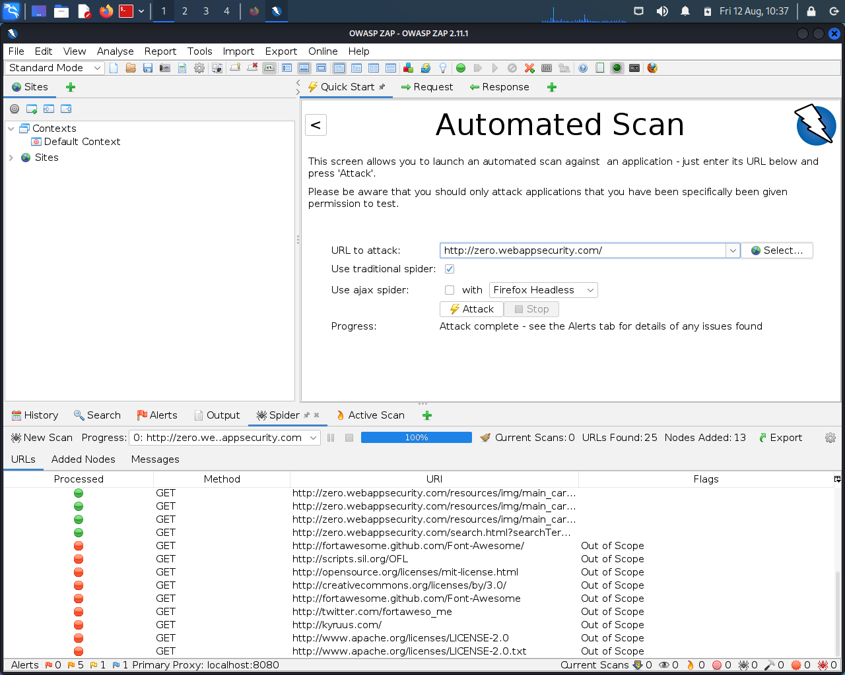
Screenshot of QWASP ZAP found vulnerabilities

Slide 3
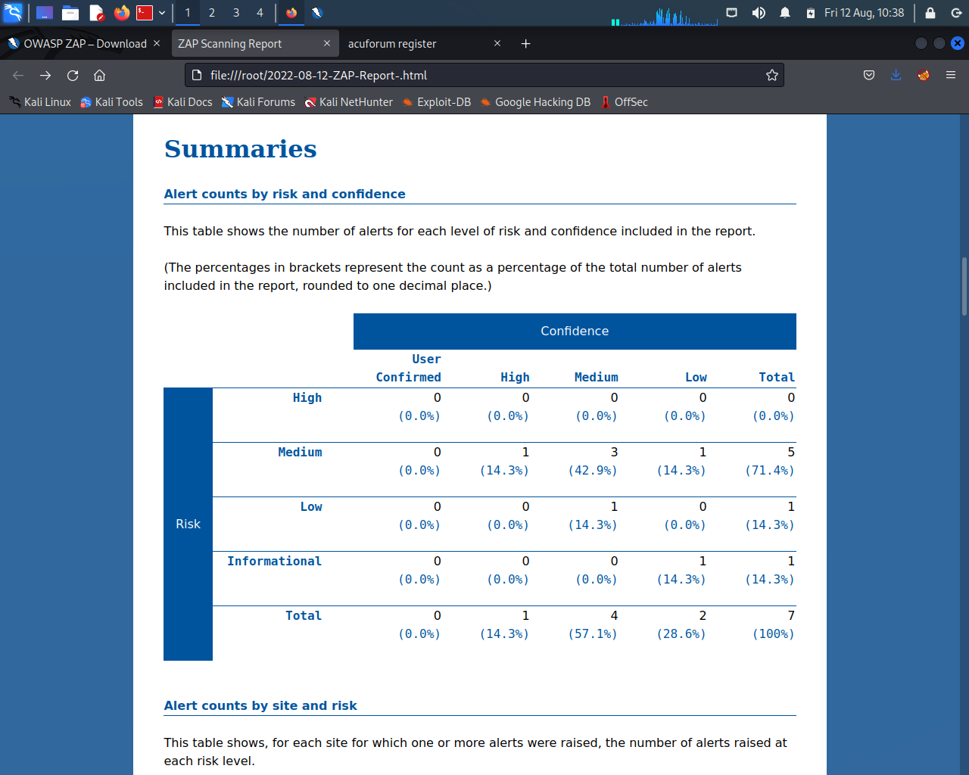
Report from QWASP ZAP

Slide 4
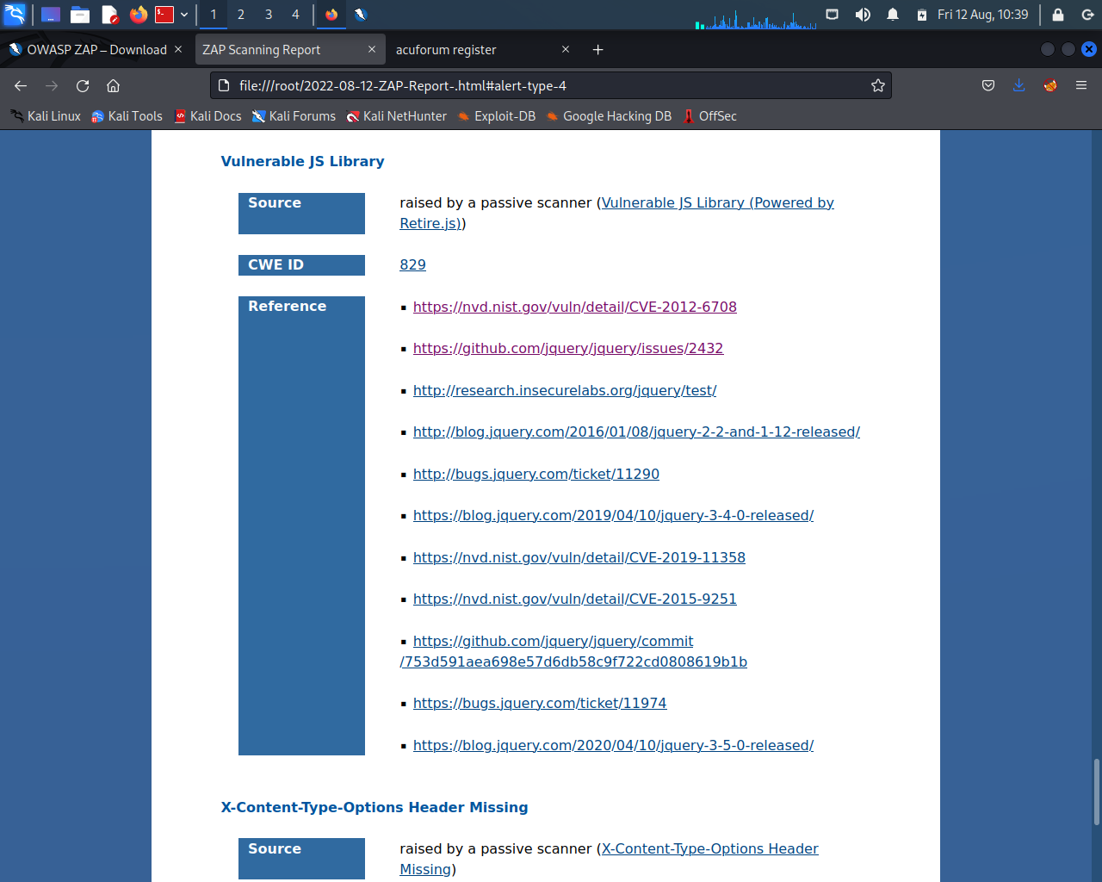
Report from QWASP ZAP(cont.)

Slide 5
Report
Title : Vulnerability in JS Library
--
Domain >> http://webappsecurity.com
Sub domain >> http://zero.webappsecurity.com/resources/js/jquery-1.8.2.min.js
--
Linux 7.1, OWASP ZAP, Wifi
--
Description : Vulnerablity in JS Library was found. The library jquery, version 1.8.2 is vulnerable.
--

Slide 6
Report (cont.)
Steps to Reproduce:
Step 1: Visit http://zero.webappsecurity.com/
Step 2: Open OWASP ZAP.
Step 3: Now in the URL to attack section paste http://zero.webappsecurity.com/
Step 4: Start Attack.
Step 5: After the successful scan view the ZAP Scanning Report.
--
Impact : Any Black Hat Hacker can hijack our users account using DOM-XSS etc.
If it happens the confidential data of our users can be stolen and can be used by others to exploit them.
It's the case of data privacy and account security of our users, who have full faith on us.
--

Slide 7
Report (cont.)
PoC : For the Proof of Concept I am attaching a various supporting document.
Screenshot of QWASP ZAP found vulnerabilities
Report from QWASP ZAP
Report from QWASP ZAP(cont.)
--

